Slide 1
From Spine Tango to a National Registry Start up Experience from Belgium
Johan G Van Lerbeirghe

Slide 2
Bylaws SSBe GOALS
Direct representation of as much as possible Belgian Specialists in Spinal pathology in (RIZIV-INAMI ( health insurance), FOD, KCE) and international stakeholders (Eurospine and others)
Promotion of quality in the care of spinal pathologies.
Creation of “National Guidelines” based on international guidelines and on an implementation of a “national registry”
Amelioration of teaching in diagnosis and therapeutic strategies in patients with spinal problems

Slide 3
History of the Belgian Pilot
2011-12 Preparation establishment SSBe
registry as common project over several societies
2013 Establishment SSBe
01/2014 First pilot registry meeting and draft project
Choice for Spine Tango as platform
Summer 2014: start of validation study of Dutch COMI-Back
Summer 2014: deal with industry for data manager
12/2014 Implant budget cut ( 36%)
Withdrawal of industry as partner
Letter to Minister
24/03/2015 First INAMI/RIZIV ad hoc spine meeting
(nomenclatura, registry, spine units, guidelines)
12/2016 Meeting with Health Data
02/2017 Dutch validation COMI-Back achieved
Quest for funding
to enhance success of
multicenter pilot

Slide 4
pre- pilot
Why Spine Tango ?
AMONG 3 EXISTING SPINE REGISTRY PLATFORMS SPINE TANGO IS THE MOST ELABORATED
REGISTRY OF NON SURGICAL TREATMENTS
MOST WIDELY USED
BENCHMARKING WITH INTERNATIONAL DATA

Slide 5
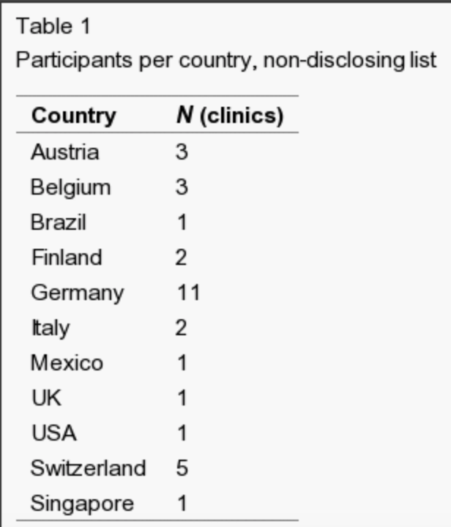
pre- pilot – Why Spine Tango?
Everard Munting, Serge Troussel, Xavier Banse

Slide 6
Experience Start of the Belgian Spine Pilot
agreement with the government
Define a Goal
B Depreitere MD, PhD
E Munting MD, PhD
P Van Schaeybroeck MD
J G Van Lerbeirghe MD

Slide 7
Goal of the Belgian Pilot
Proof of concept feasibility of registering
large scale
sufficient response rate
lasting
Investigate the most efficient and cost-effective organizational format that ensures ongoing registration with sufficient response rates. ( even external partners ( lynxcare))
150K from RIZIV/INAMI
As preparation for the nation-wide implementation in a second stage
LAUNCH April 2018
OVER 3 YEARS
SUMMER 2019 ?

Slide 8
The Belgian Pilot
Indications for registration in the pilot trial are:
Surgical patients
All Consecutive Lumbar Surgery Patients
Conservative patients
All “K60” nomenclatura procedures rehabilitation included
Code of Conduct for users.

Slide 9
The Belgian Pilot
Forms that will be filled are:
For the caregiver
Spine Tango surgery form
Spine Tango conservative care form
Spine Tango follow-up forms
For the patient : patient reported outcome measurements (PROMs)
Core Measure Outcome Index (validated in French or Dutch)
EQ5D quality of life questionnaire (validated in French or Dutch)
The patient forms will be accessible electronically, (but also the option of paper forms will be offered when necessary.)

Slide 10
The Belgian Pilot
The timing of data registration is:
Caregiver: at intervention
Hospital discharge for surgery
Start/end of therapy for conservative management
Therapy is one specific treatment or set of multiple therapeutic interventions (excluding surgery)
Patient:
Pre-intervention (intervention = surgery or first actual conservative K60 treatment)
Follow-up
3m, 6m, 1y, 2y

Slide 11
The Belgian Pilot
Data manager task
actively remind late/non-repliers in the patient population
ensure swift data entries by the hospitals (in close collaboration with the hospital secretarial offices)
explore different strategies that are aimed at enhancing response rates (paper alerts, telephone alerts, electronic alerts, patient contracts, …)
Trigger is Day zero operation or K60 conservative treatment
Preop, 3m,6m,1y,2y
Final report at 3y

Slide 12
“Health Data”
Privacy and informed consent
Will not need to be approved by the hospitals ethic committees
Sectoral Committee of the privacy commission approval( informed consent)
Data Entry
Hospital based and computer programming of spine tango forms by Health Data

Slide 13
The Belgian Pilot ( 15 centers)
Prof. dr. Everard Munting, Clinique Saint-Pierre, Ottignies
Dr. Serge Troussel, Grand Hôpital de Charleroi, Charleroi
Prof. dr. Xavier Banse, UCL, Woluwe
Dr Robert Gunzburg, Edith Cavell, Brussels
Dr. Geneviève Mahieu, CHU Dinant, Dinant
Dr. Patrick Van Schaeybroeck, AZ Imelda, Bonheiden
Dr. Jan Sys, AZ Sint-Blasius, Dendermonde
Dr. Johan van Lerbeirghe, AZ St Lucas, Gent
Dr. Thierry Parlevliet, UZGent, Gent
Prof. dr. Bart Depreitere, UZLeuven, Leuven
Dr. Hisco Robijn, Regionaal Ziekenhuis Tienen, Tienen
Dr. Ricky Rasschaert, Middelheim, Antwerpen
Dr. Dominique Verhulst, Stuivenberg, Antwerpen
Prof. dr. Michaël Bruneau, ULB Erasme, Brussels
Dr. Dieter Peuskens, ZOL Genk

Slide 14
The Belgian Pilot
TO BE CONTINUED…
THANK YOU

